Slide 1
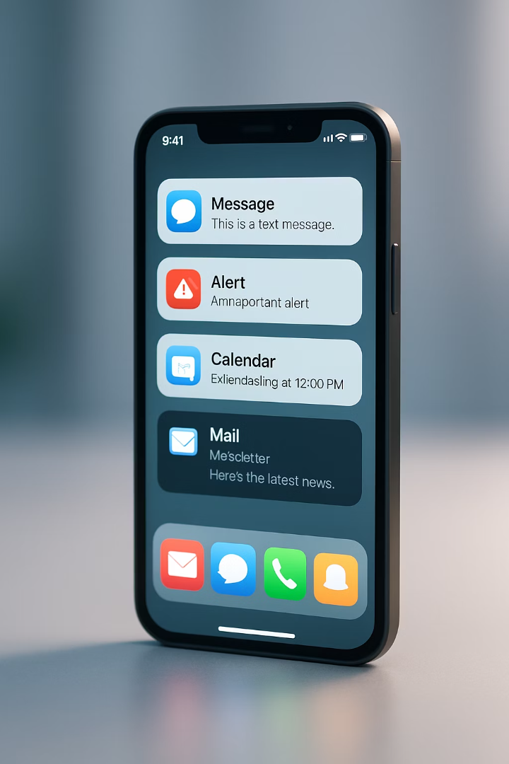

Mobile App Notifications: Enhancing User Experience
Welcome to this comprehensive guide on handling notifications in mobile apps. Notifications are a powerful tool for engaging users and providing timely information, even when your app isn't actively being used. When implemented effectively, they can significantly enhance the overall user experience and encourage users to return to your app.
In this presentation, we'll explore the different types of notifications, their implementation, and best practices for creating a notification strategy that resonates with your users without overwhelming them.

Slide 2

Learning Objectives
1
Understand Notification Purpose
2
Compare Notification Types
Explain how notifications enhance user experience and engagement
Distinguish between local notifications and push notifications
3
Develop Push Notifications
4
Master In-App Notifications
Learn the implementation steps for effective push notifications
Understand the various types of in-app notifications and their purposes

Slide 3
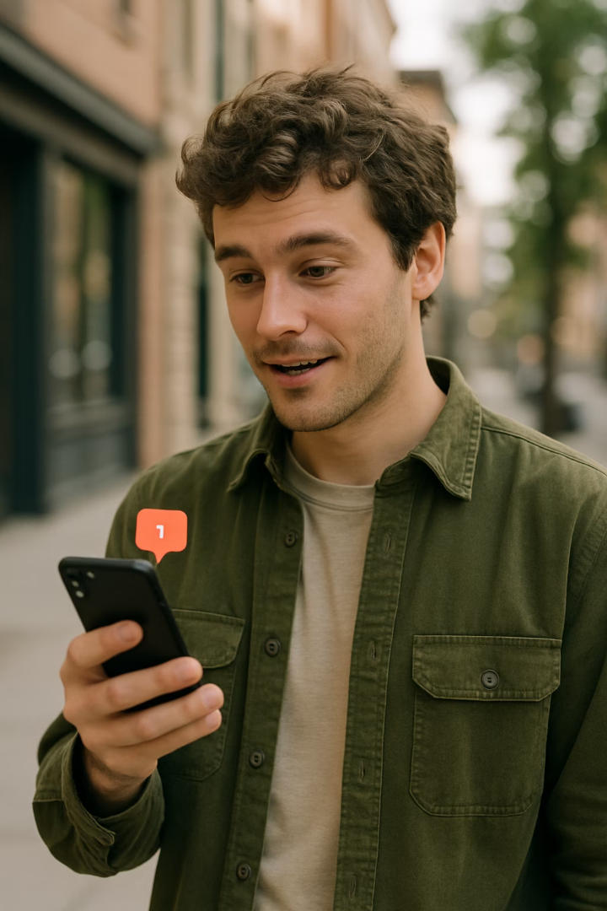
The Purpose of Notifications
User Engagement
Timely Information
Notifications actively engage users by providing relevant information and prompting interaction with your app.
Deliver important updates and time-sensitive information even when users aren't actively using your app.
Return Triggers
Strategic notifications encourage users to return to your app, increasing retention and overall usage.
Notifications serve as a direct communication channel between your app and users. When implemented thoughtfully, they can significantly enhance the user experience by providing value at the right moment, whether the app is active or not.

Slide 4
Types of Notifications: Push vs. Local
Push Notifications
Local Notifications
Messages sent from a server to the user's device
Messages generated by the app itself
Triggered by external events
Based on predefined conditions or rules
Can reach users even when app is closed
Triggered by user interaction or time
Example: New message alerts or product sales
Example: Calendar reminders or scheduled alerts
Understanding the difference between these notification types is crucial for implementing the right solution for your specific use case. Each serves different purposes and requires different implementation approaches.

Slide 5
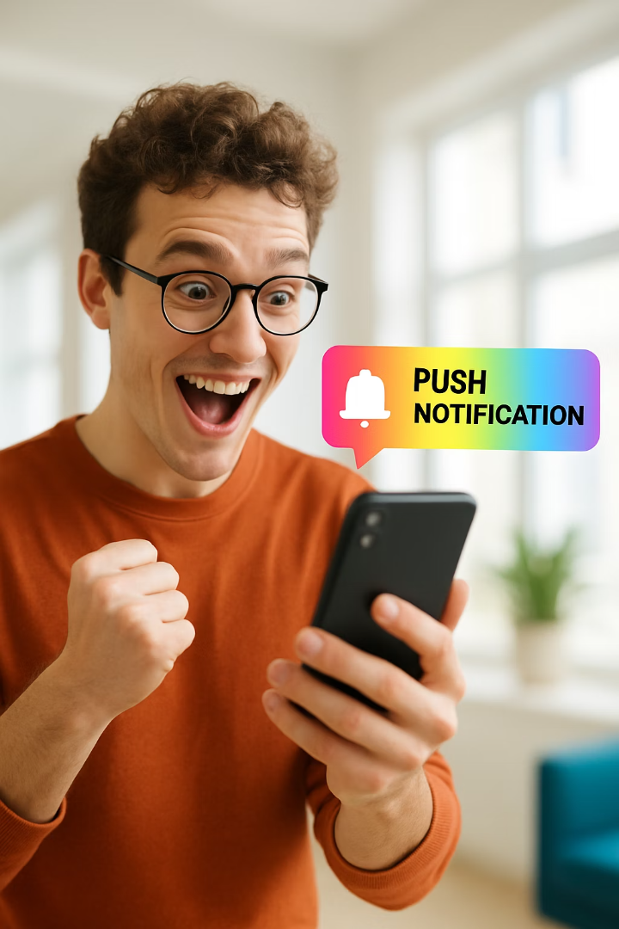



Push Notifications in Action
Shopping Apps
Messaging Apps
News Apps
Alert users about flash sales on favorite products, creating urgency and prompting immediate action.
Inform users about new messages or important conversations requiring attention.
Deliver breaking news alerts and timely updates on topics users have expressed interest in.
Push notifications are particularly effective for time-sensitive information that might lose value if not seen promptly. They create a direct line to users, grabbing their attention and encouraging immediate engagement with your app.

Slide 6
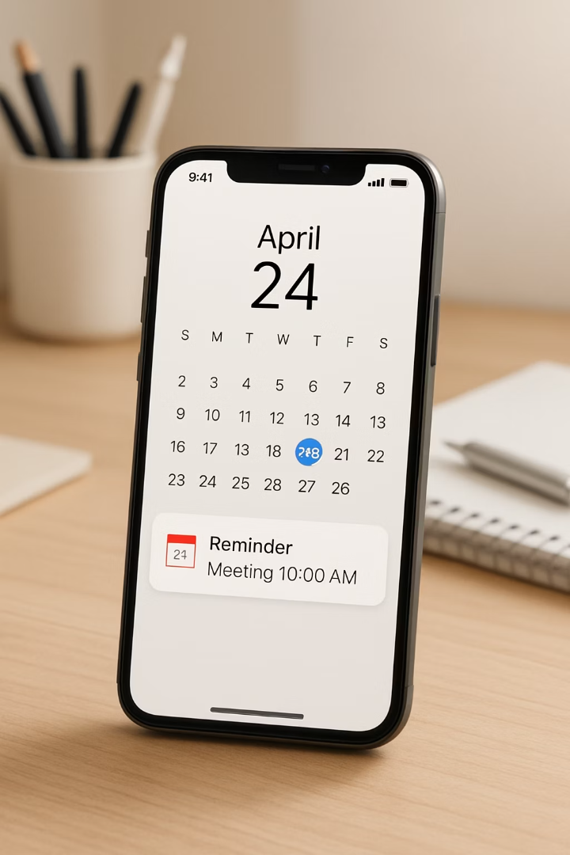




Local Notifications Use Cases
Calendar Apps
Send reminders before scheduled meetings or events at specified times.
Fitness Apps
Remind users about scheduled workouts or daily activity goals.
Health Apps
Alert users to take medication at specific times throughout the day.
Task Management
Notify users about upcoming deadlines or task due dates.
Local notifications excel in scenarios where the trigger is based on time or user-defined parameters within the app. They're ideal for personal reminders and scheduled alerts that don't require server communication.

Slide 7



Push Notification Services
Apple Push Notification service (APNs)
Apple's service for iOS devices
Firebase Cloud Messaging (FCM)
Required for iOS push notifications
Google's service for Android devices
Secure, encrypted delivery
Reliable delivery to Android devices
Supports rich notifications with media
Supports targeting specific user segments
Cross-Platform Libraries
Provides analytics on notification performance
Tools like React Native push notifications
Simplify implementation across platforms
Reduce development time
Maintain consistent user experience
Operating systems provide dedicated services for push notification delivery. Understanding these platforms is essential for implementing reliable push notifications in your mobile applications.

Slide 8
Implementing Push Notifications
Implement with FCM or APNs
Generate Device Token
Use the generated token with Firebase Cloud Messaging (for Android) or Apple Push Notification service (for iOS) to enable server-to-device communication.
Obtain User Permission
After permission is granted, have the device generate a unique token that identifies the device and provides authorization for the server to send notifications.
Request notification permissions when the user first launches the app. This is a critical step as users must explicitly opt-in to receive notifications from your app.
Following these steps ensures that your push notification system is properly set up and respects user preferences. Remember that obtaining explicit permission is not just a technical requirement but also a matter of respecting user privacy.

Slide 9






In-App Notifications Overview
Contextual Information
Provide relevant information in the current context
Feature Discovery
Guide users to discover new or underused features
Navigation Assistance
Help users navigate complex interfaces or processes
In-app notifications appear only while the app is in use, making them ideal for contextual information and guidance. Unlike push or local notifications, they don't interrupt users outside of the app experience, creating a more seamless interaction flow.
These notifications can significantly improve user experience by providing timely information, encouraging feature exploration, and guiding users through complex processes within your application.

Slide 10
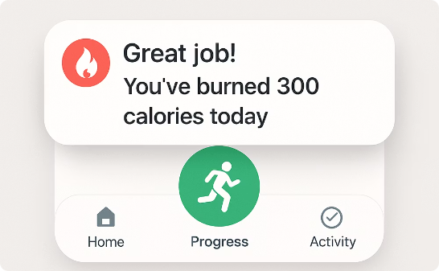
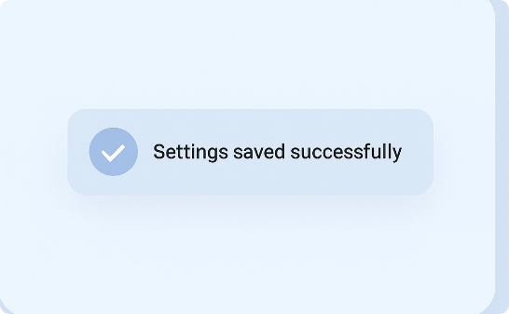
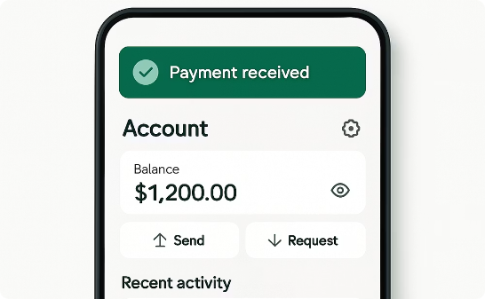
Toast Notifications
Fitness Achievement
Action Confirmation
Transaction Updates
Provide immediate feedback on workout completion, motivating users to continue their fitness journey.
Confirm that user actions like saving settings or completing tasks have been successfully processed.
Notify users about successful transactions or important account updates that require brief attention.
Toast notifications appear briefly and then disappear automatically without requiring user interaction. They're perfect for providing non-critical feedback that doesn't interrupt the user's current task flow.

Slide 11



Modal Notifications
Critical Alerts
Inform users about important issues requiring immediate attention
Action Confirmations
Confirm potentially destructive actions before proceeding
User Input Collection
Gather essential information through focused input forms
Modal notifications, also known as pop-ups, interrupt the user experience by requiring interaction before the user can continue using the app. Because of their intrusive nature, modals should be reserved for truly important interactions where user attention or confirmation is essential.
When designing modals, keep them concise and provide clear actions for users to either proceed or dismiss the notification.

Slide 12
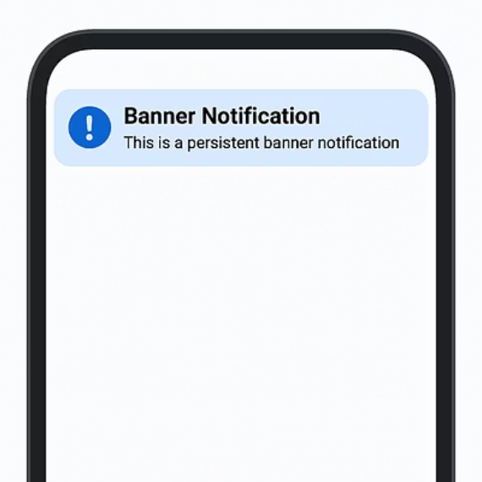
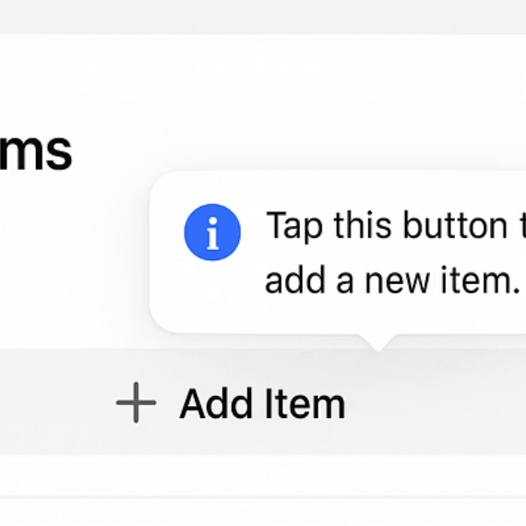
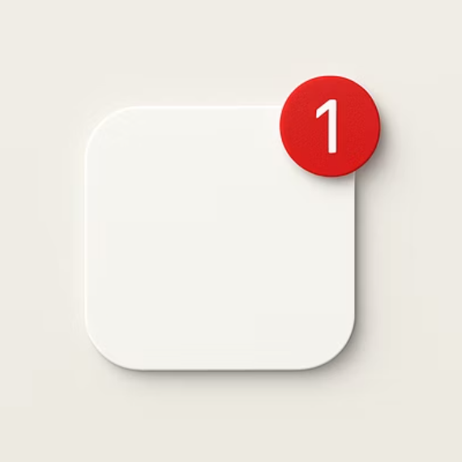



Other In-App Notification Types
Banner Notifications
Tooltip Notifications
Badge Indicators
Persistent notifications that remain visible until dismissed, ideal for ongoing information or important updates.
Contextual hints that appear when users interact with specific elements, perfect for explaining complex features.
Small visual indicators on app icons or sections signaling new content or unread messages.
Each of these notification types serves a specific purpose in your app's communication strategy. Choosing the right type depends on the importance of the information, the user's current context, and the level of interruption appropriate for the message.

Slide 13

Best Practices for Notification Implementation
1
2
Use Judiciously
Analyze Metrics
Avoid notification fatigue by only sending truly valuable information
Track engagement to identify which notifications resonate with users
3
4
Gather Feedback
Find Balance
Regularly collect user preferences to refine notification strategy
Strike the right balance between engagement and respecting user attention
The most effective notification strategies prioritize user experience over engagement metrics. Remember that each notification represents an interruption in your user's day, so ensure that the value provided justifies this interruption.

Slide 14
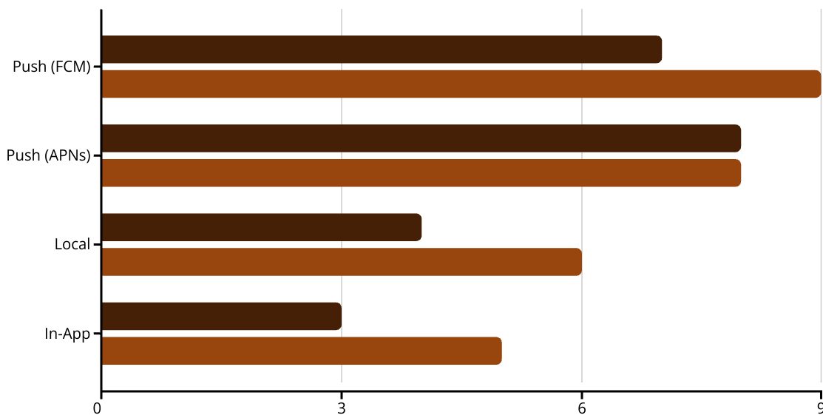
Technical Implementation Considerations
Development Complexity
User Reach Potential
When implementing notifications, consider both the technical complexity and the potential reach of each notification type. Push notifications generally require more setup but offer greater reach, while in-app notifications are simpler to implement but limited to active users.
Familiarize yourself with platform-specific documentation for FCM and APNs to ensure proper implementation and take advantage of platform-specific features that can enhance your notification strategy.

Slide 15
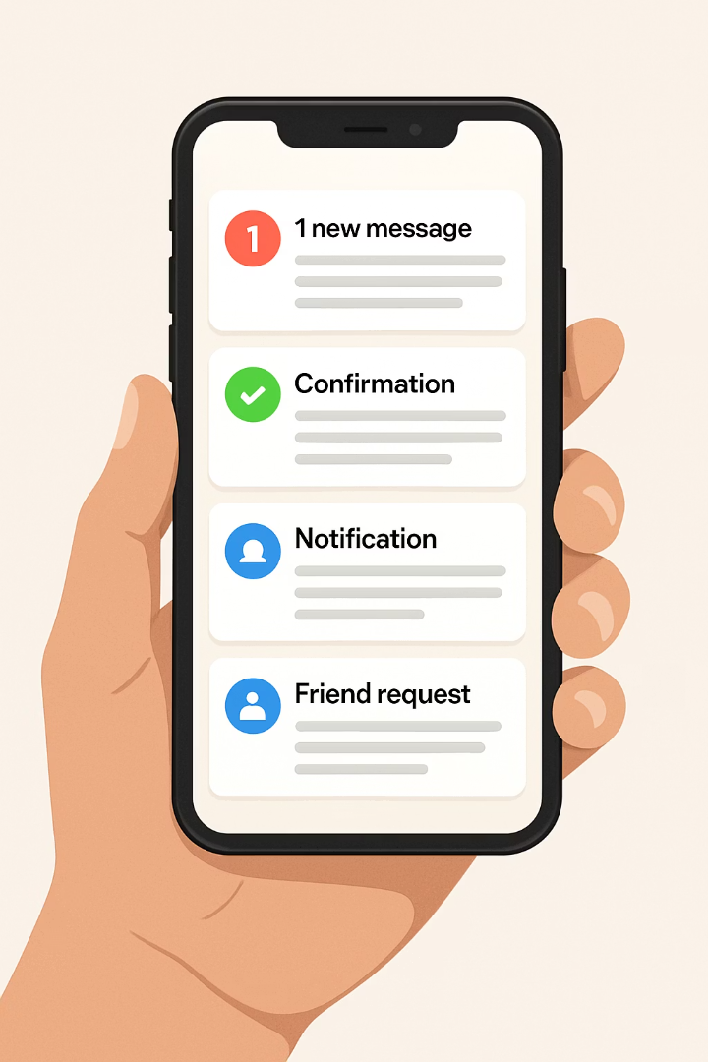
Key Takeaways
Notification Purpose
Notifications inform users about events, deliver timely information, and encourage app engagement
Notification Types
Push notifications come from servers, while local notifications are generated by the app itself
Implementation Steps
Obtain permission, generate a token, and use cloud messaging services for push notifications
In-App Varieties
Toast, modals, banners, tooltips, and badges serve different purposes within your app
Notifications are a powerful tool for enhancing user experience and engagement when implemented thoughtfully. By understanding the different types of notifications and their appropriate use cases, you can create a notification strategy that provides value to users without overwhelming them.
Remember to continuously analyze user engagement with your notifications and adjust your approach based on feedback and performance metrics.

